Slide 1




2021 Spring Hack-A-Roo Use case: Alachua County
Covid-19 Vaccination Big Data Platform
Prakhya Srungarapu
Sai Saranya Vipparla
Vamshi Krishna Routhu
Shiva Kumar Murarishetti

Slide 2
Introduction
Objective
Features
Significance
Workflow
Data
Tools & Technologies
Implementation

Slide 3
Introduction
Right now we don't need new creates for Coronavirus antibodies, since we as of now have many promising ones. We need to figure out some approach to back the current ones to get them out into this world .The circulation of vaccines to states and territories, just as checking their dispersion to people should handily be possible by having the legitimate investigation of individuals information who are really in need of vaccination.
Guaranteeing that enough immunizations are managed would be a verifiably difficult undertaking. Nonetheless, million portions of vaccination might be needed to disseminate among individuals relying upon the time frame and power of vaccine, there are as yet numerous worries from individuals with regards to the immunization connecting with public which will be unmistakably executed in our task in type of information examination.

Slide 4
Objective
We have taken county based covid vaccine dataset in order to create awareness in public with respect to the supply of vaccine doses in their county.
To analyze the data based on several factors such as type of vaccine, their supply, region, health conditions. We will be using different Hadoop ecosystem tools to collect the data, store, analyze and generating visualizations.

Slide 5
Significance
As numerous counties can't supply the vaccine for their population, the public authority ought to have the track of the immunization supply.
How the supply ought to be done?
This would be useful for the public authority and the commoners to settle on their choice towards the vaccination.

Slide 6
Features
The features of this project would be analysis on the covid vaccination data based on county. Storing the data in the HDFS, Processing data using Spark, Querying using Hive Query language. Generating visualizations using matplotlib, Seaborn. Showing the visualizations on the web application.

Slide 7
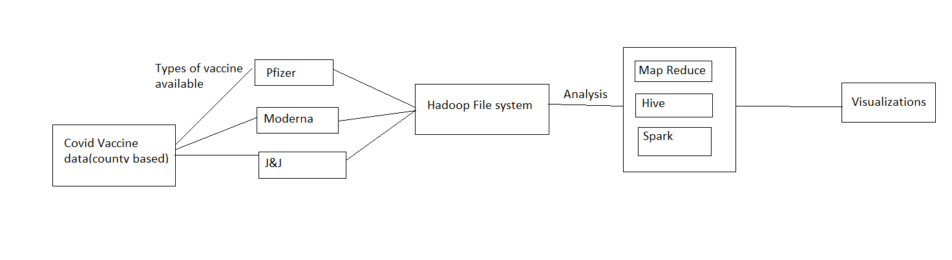
Workflow

Slide 8
Data
County Based covid vaccine data.
Data includes type of vaccines supplied to that county – Pfizer, Moderna, J&J.

Slide 9
Tools & Technologies
Google collab
Apache Hadoop
Hive
Apache Spark – PySpark

Slide 10

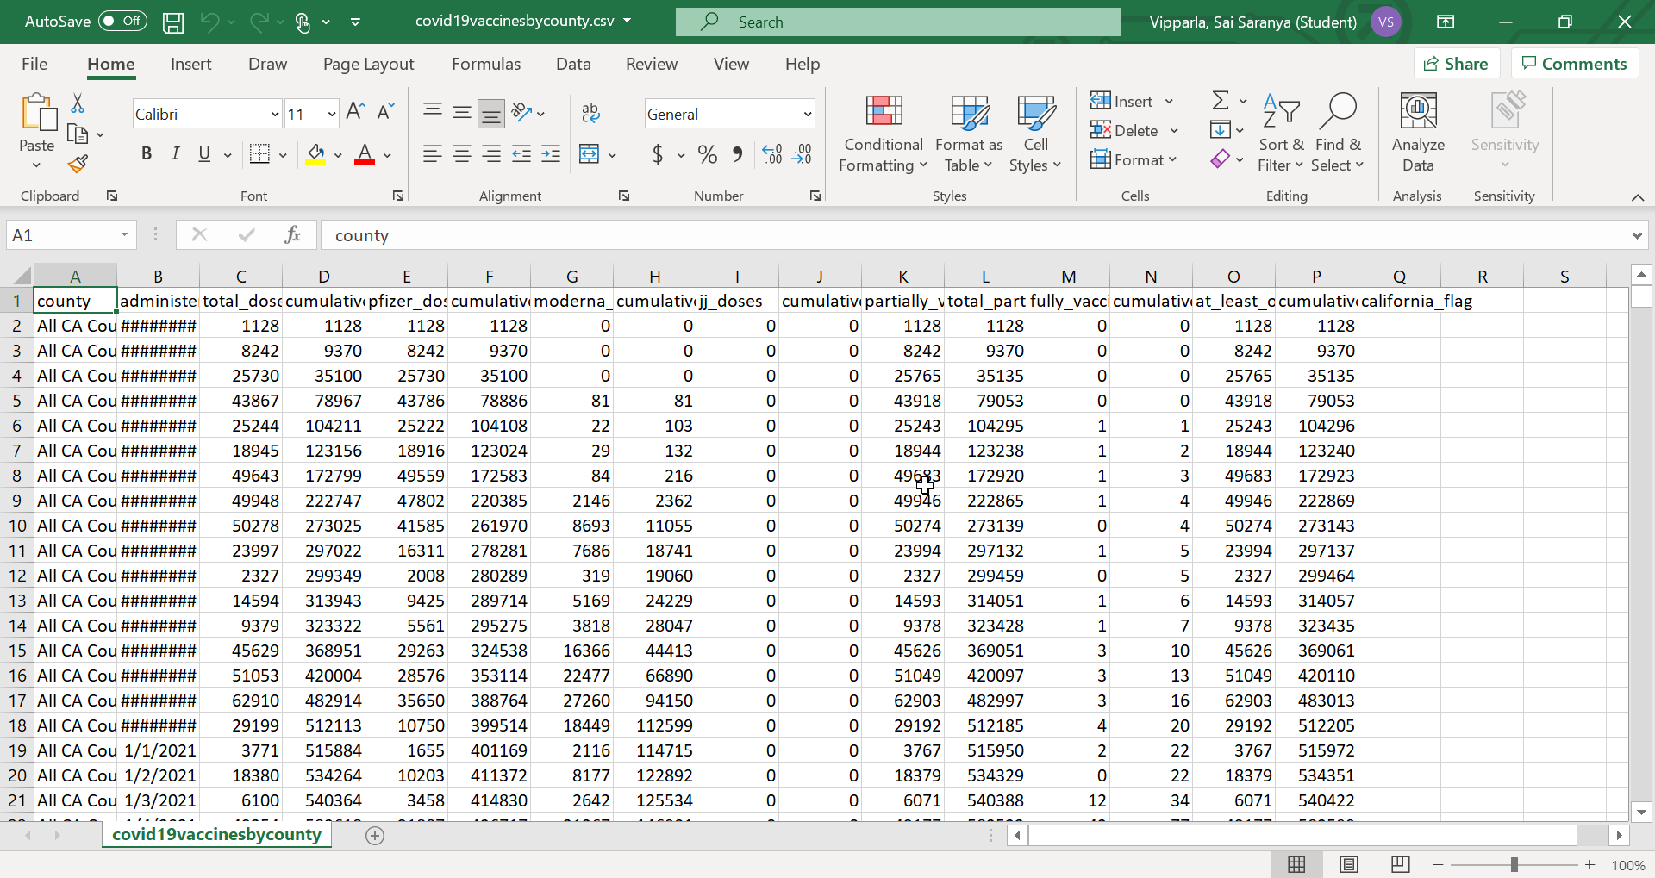
Code Snippet
Data Used

Slide 11
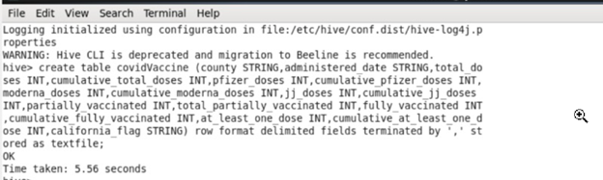
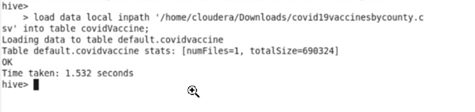
Creating Table covid Vaccine in Hive :
Loading data In Hive :

Slide 12
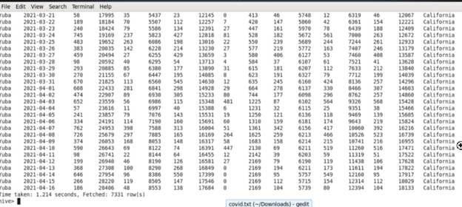
Data in table covidVaccine:

Slide 13
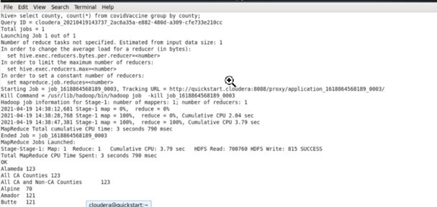
Cities being considered in that county for vaccine supply :

Slide 14
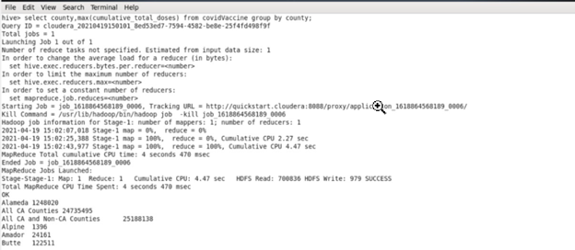
How much Supply of doses (maximum doses) is going to particular county :

Slide 15
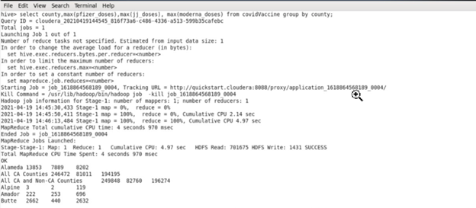
Maximum doses of individual vaccines in each county:

Slide 16
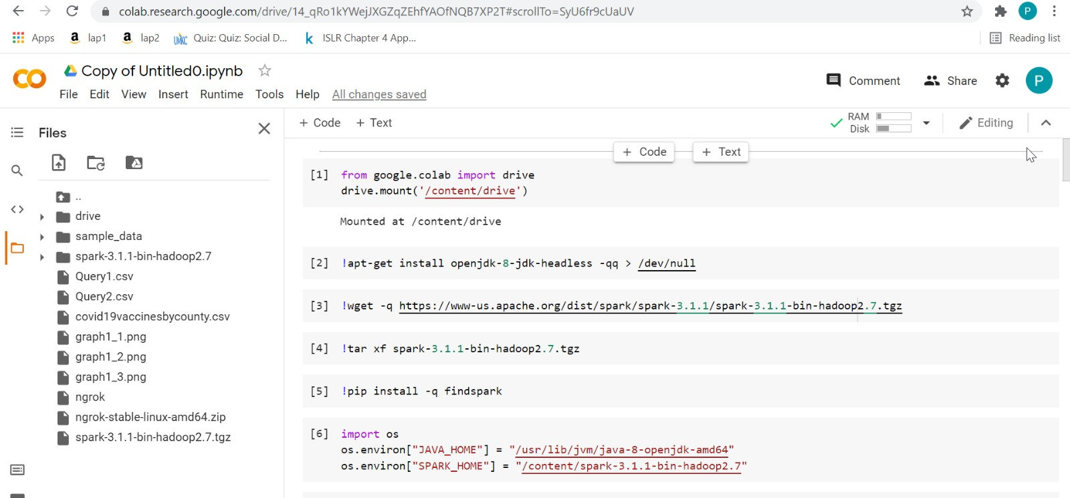
Google Collab:

Slide 17
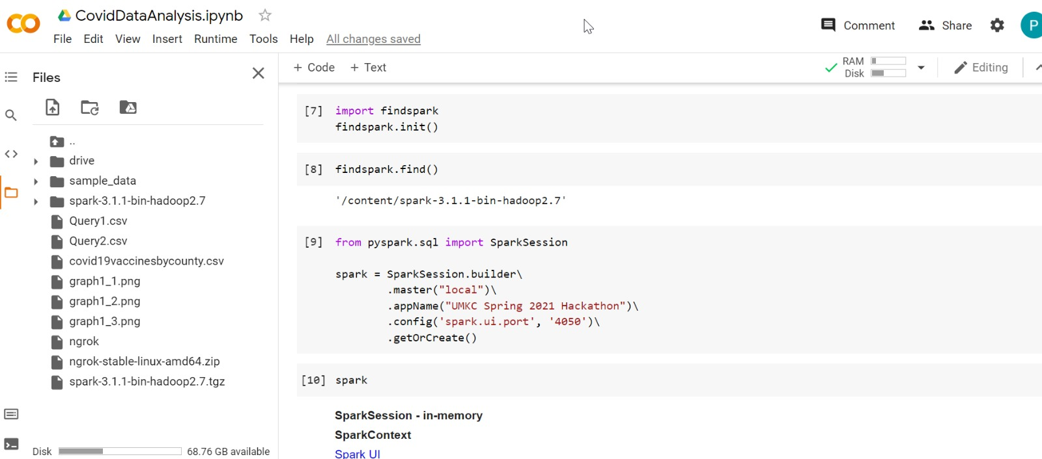
Google Collab:

Slide 18
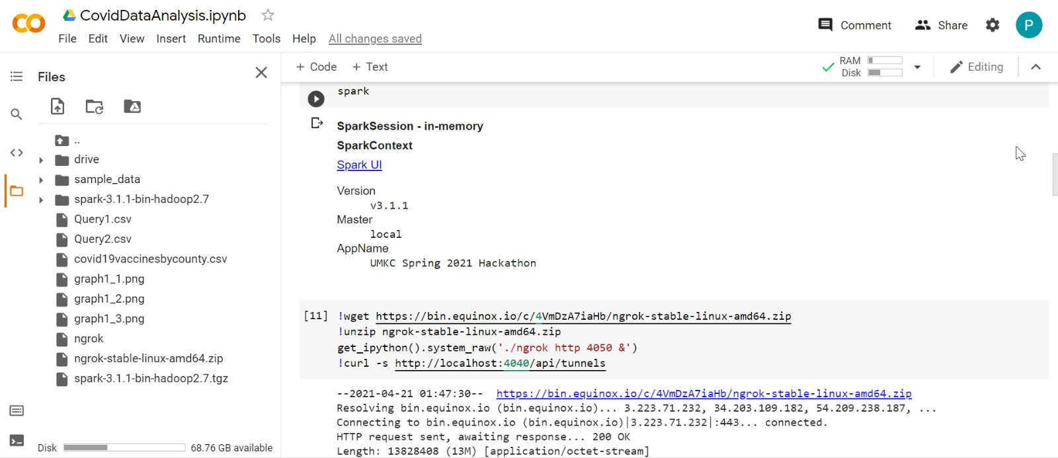
Spark:

Slide 19
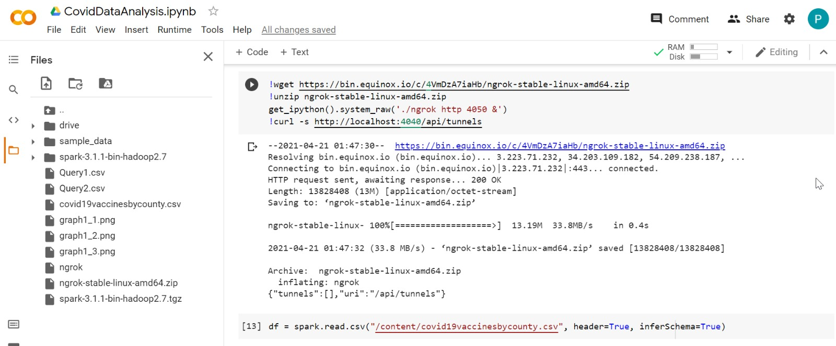
Spark:

Slide 20
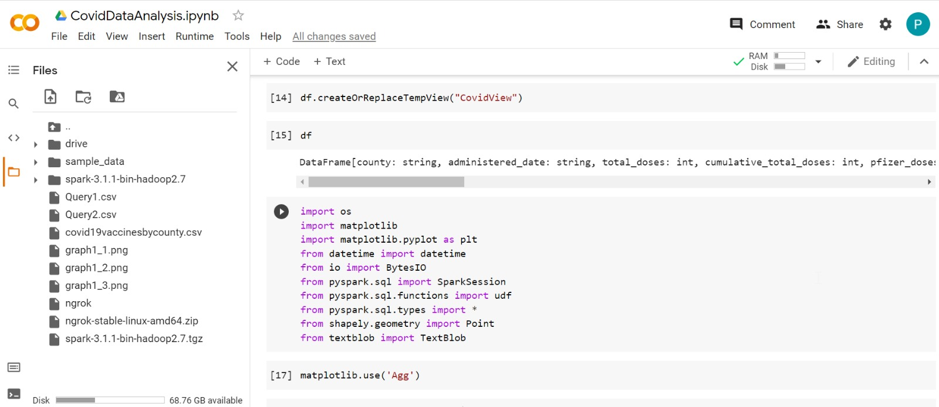
Spark:

Slide 21
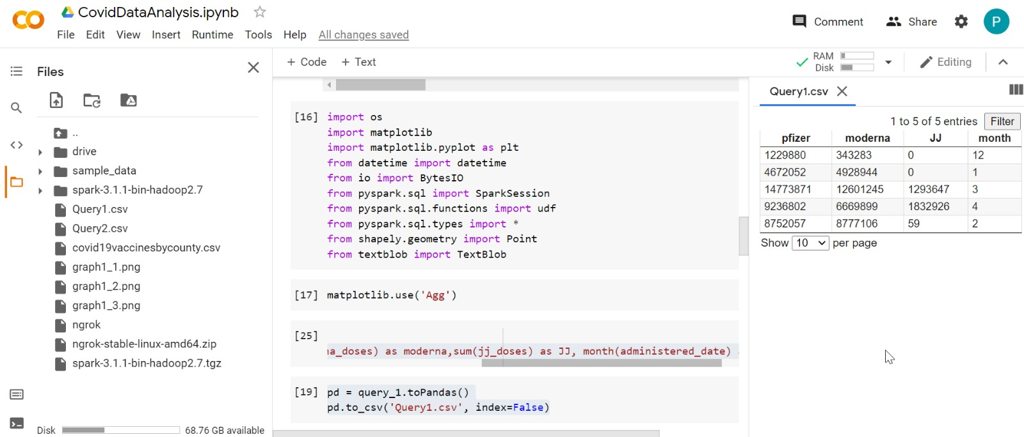
Output

Slide 22
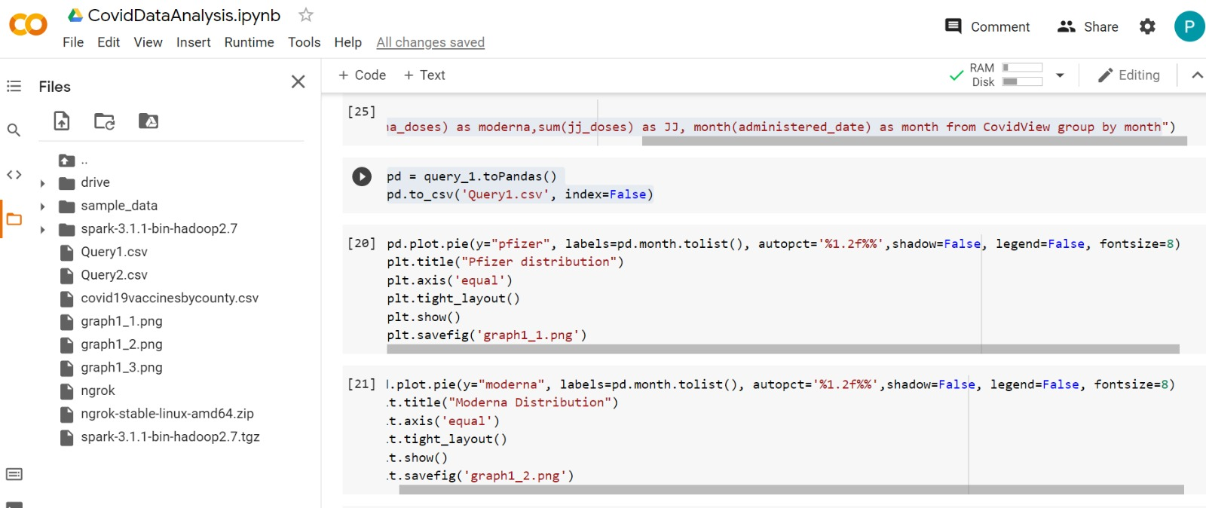
Visualization:

Slide 23
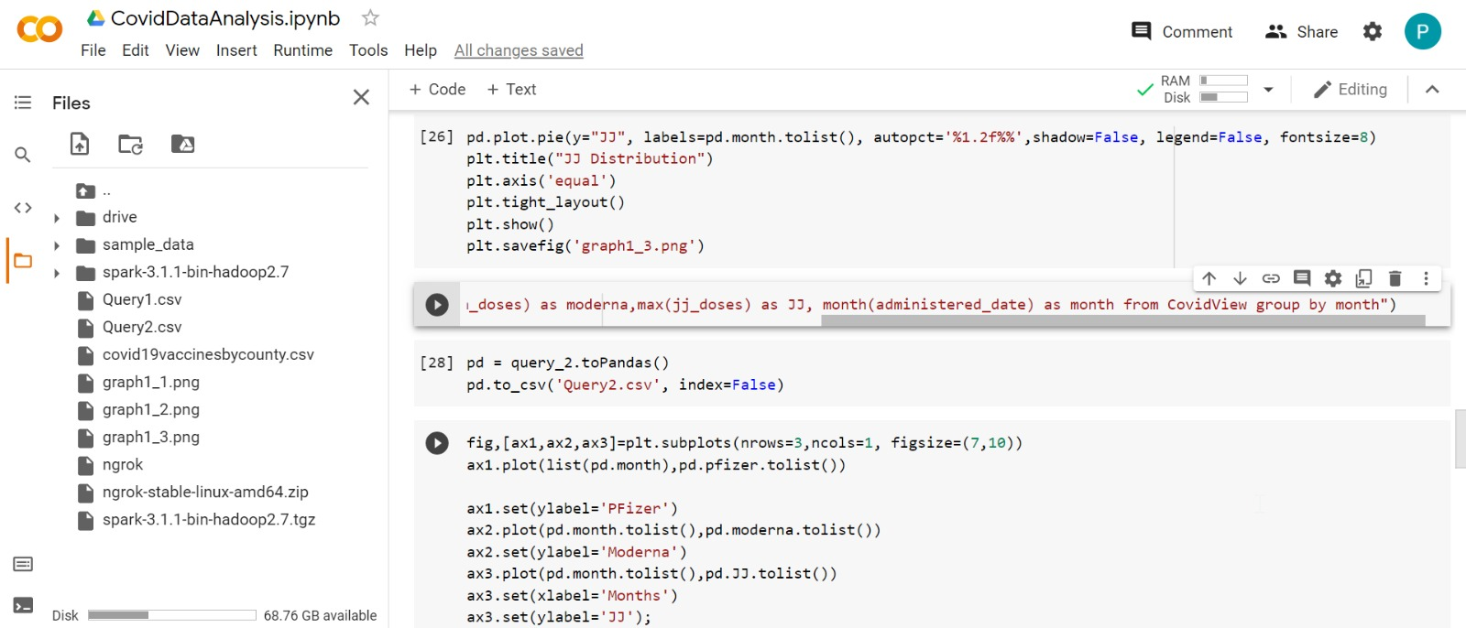
Visualization:

Slide 24
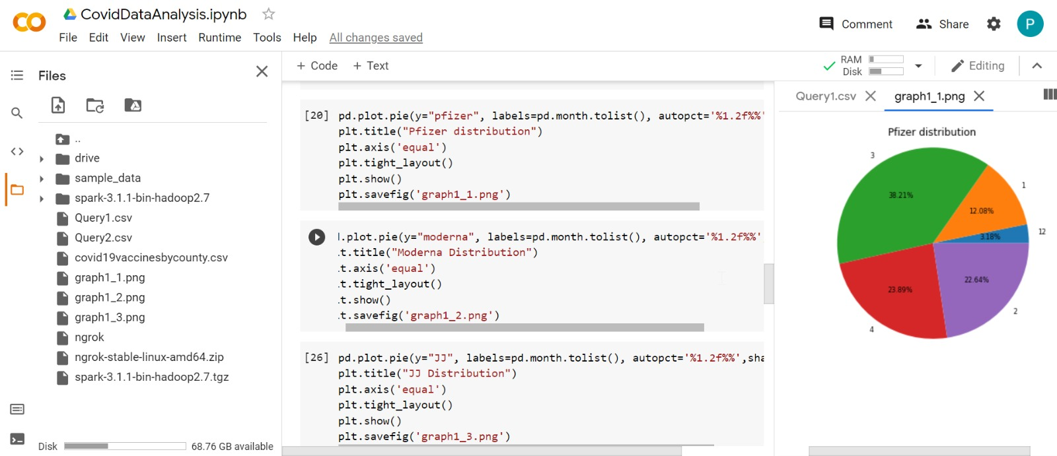
Pfizer Distribution:

Slide 25
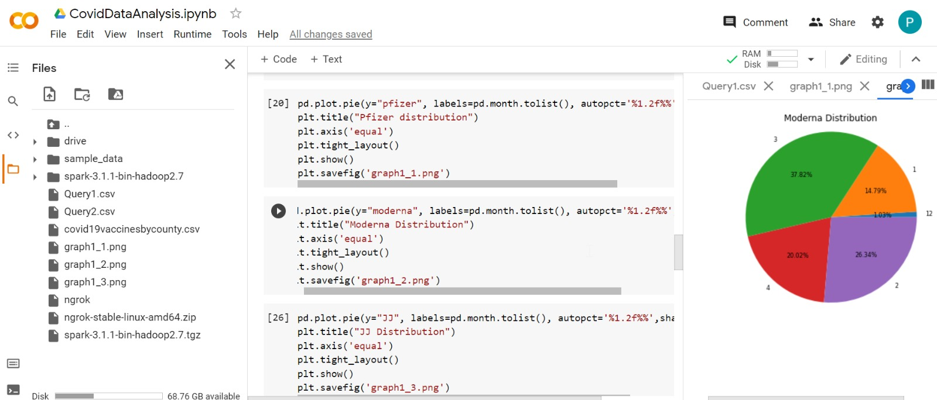
Moderna Distribution:

Slide 26
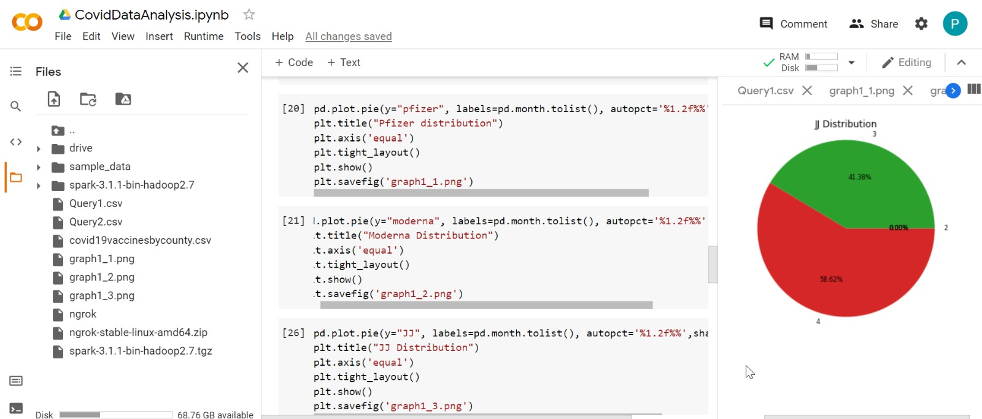
JJ Distribution:

Slide 27
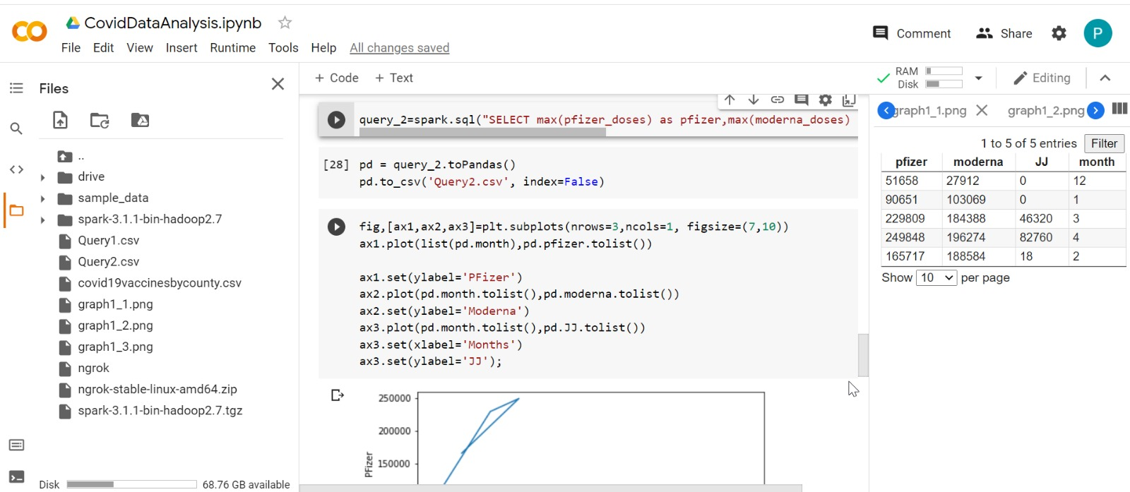
Monthly Distribution:

Slide 28
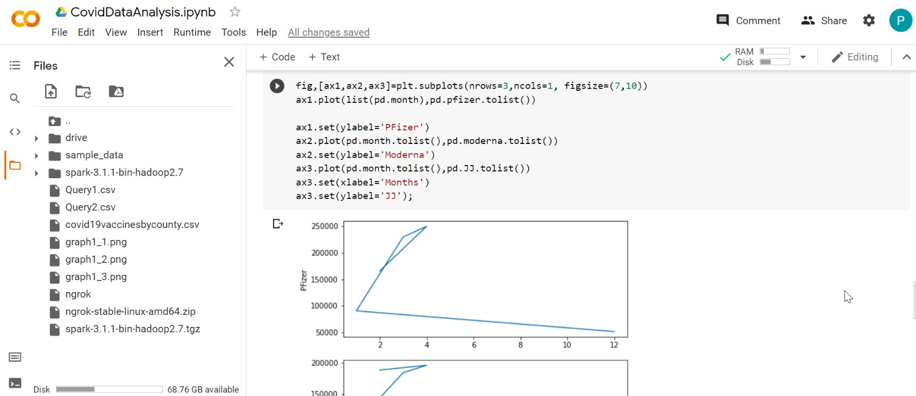
Monthly Distribution:

Slide 29
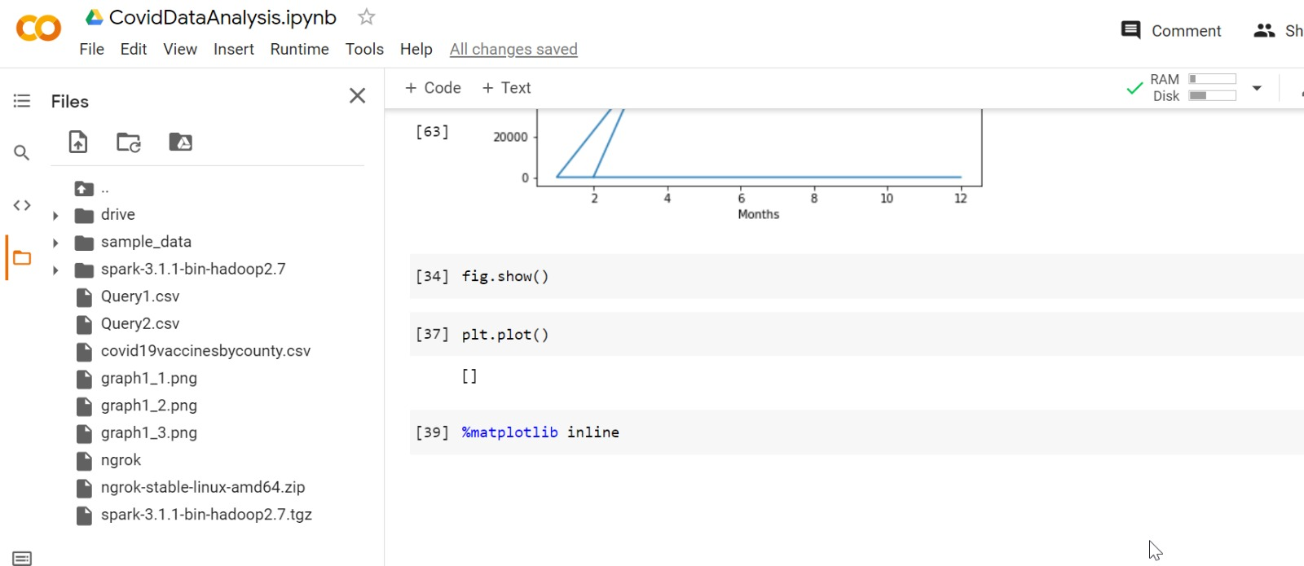
Monthly Distribution:

Slide 30
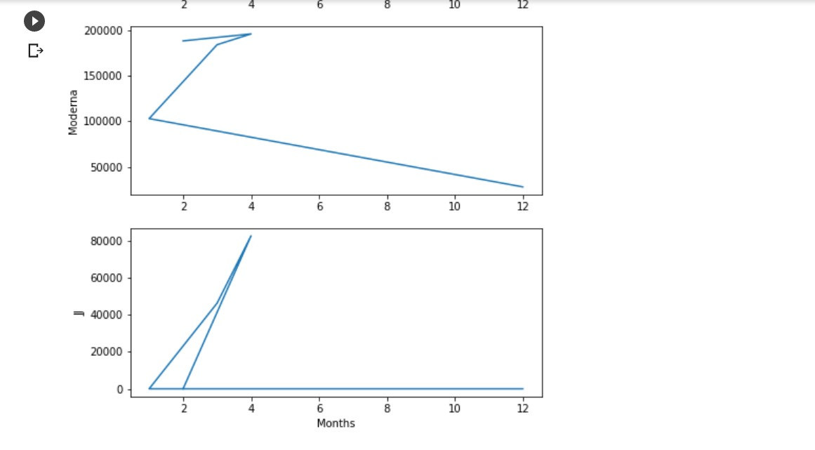
Monthly Distribution:

Slide 31
Thank You…

